Slide 1
The Burden of halth inequity as a Barometer of social justice Global trend and challenges in Mexico Introduction to equinomics Juan Garay EU Delegation to Mexico

Slide 2
International references of best feasible/sustainable health

Slide 3
HRS models
Country Name | average 1960-2012 | average 1980-2012
Costa Rica | 72.93 | 76.72
Cuba | 73.51 | 76.08
Albania | 71.00 | 73.52
Vietnam | 68.92 | 72.08
St. Lucia | 68.32 | 71.67
Belize | 68.89 | 71.25
Georgia | 69.54 | 71.19
Sri Lanka | 68.26 | 70.92
Armenia | 70.15 | 70.79
St. Vincent | 67.87 | 70.34
Tonga | 68.09 | 70.23
Colombia | 66.45 | 69.92
Grenada | 67.19 | 69.58
Paraguay | 67.84 | 69.36

Slide 4
Burden of health inequity (ref HFS standards)
Weighted average of mortality/survival rate per age group, sex and annual average/5y 1950-2010
Adjusted mortality rates to estimate expected deaths by HRS standards.
Burden of global health inequity : excess mortality
NBGHiE : umber of avoidable deaths (or LYlost)
RBGHiE : % of deaths which would be avoidable (or DL pc and year due to inequity)

Slide 5
Total number of avoidable deaths 1950-2010
Period | Global avoid deaths
1950-1955 | 22378571
1955-1960 | 22359125
1960-1965 | 23681287
1965-1970 | 17540402
1970-1975 | 15953937
1975-1980 | 16333040
1980-1985 | 16360286
1985-1990 | 16561451
1990-1995 | 17603116
1995-2000 | 18591914
2000-2005 | 17428328
2005-2010 | 16821851

Slide 6
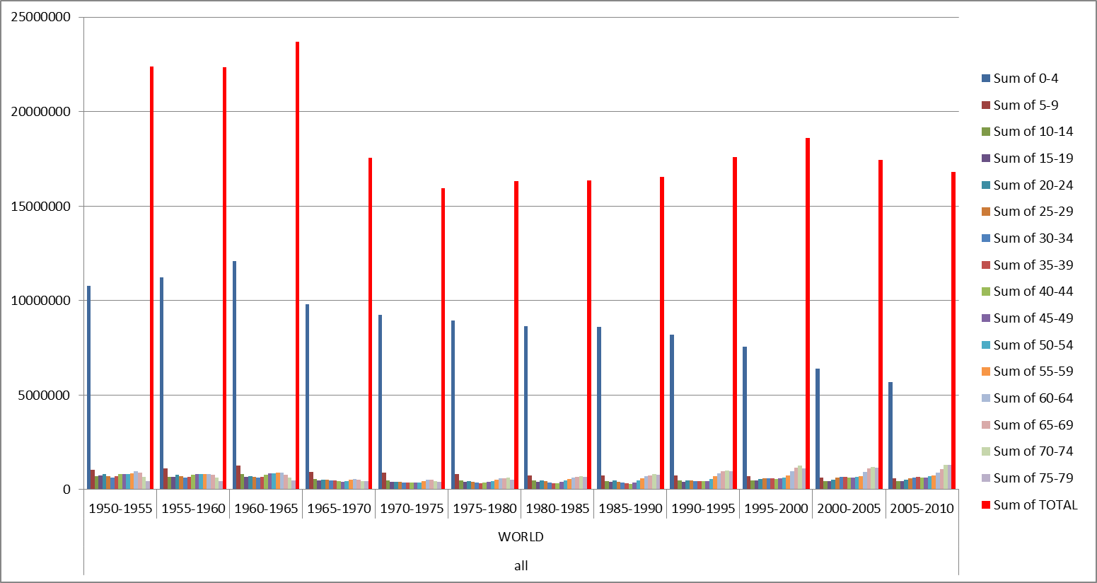
Trend and distribution of NGHiE

Slide 7
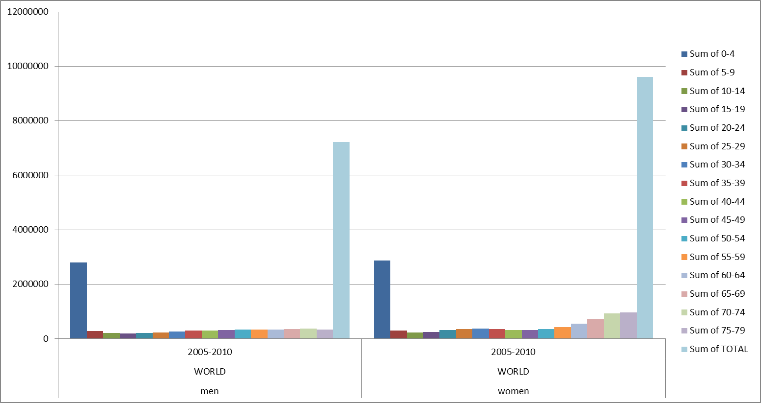
GBHiE 2005-2010 by sex and age group

Slide 8
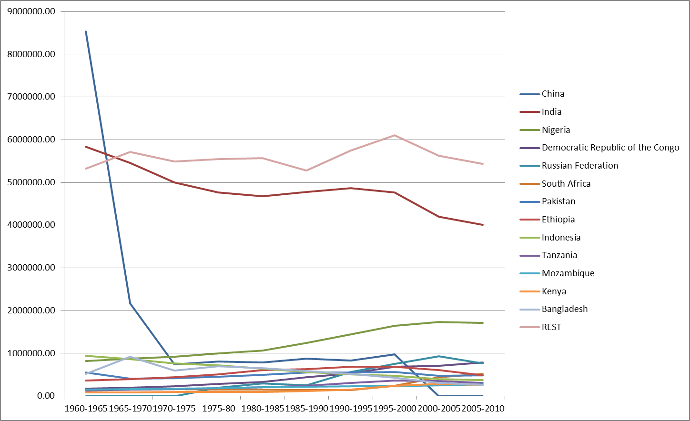
Countries with highest GBHiE, trend 1960-010

Slide 9
RBGHiE 1950-2010
Period | % global av deaths
1950-1955 | 46.9%
1955-1960 | 47.6%
1960-1965 | 49.3%
1965-1970 | 42.4%
1970-1975 | 39.3%
1975-1980 | 40.9%
1980-1985 | 40.6%
1985-1990 | 40.7%
1990-1995 | 42.1%
1995-2000 | 43.5%
2000-2005 | 40.6%
2005-2010 | 39.4%

Slide 10
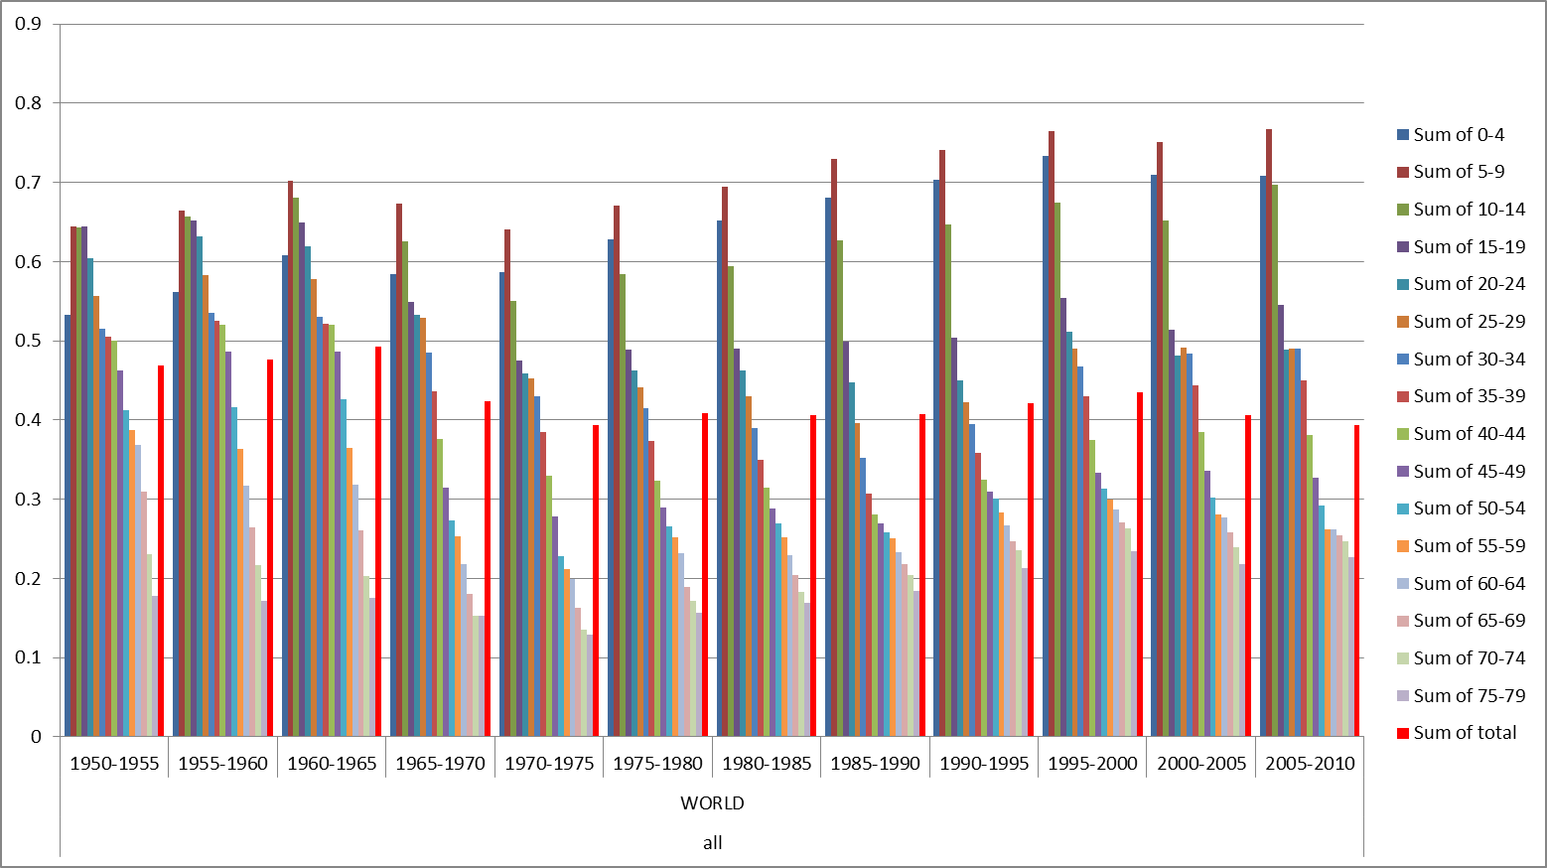
RBGHiE 1950-2010 by age groups

Slide 11
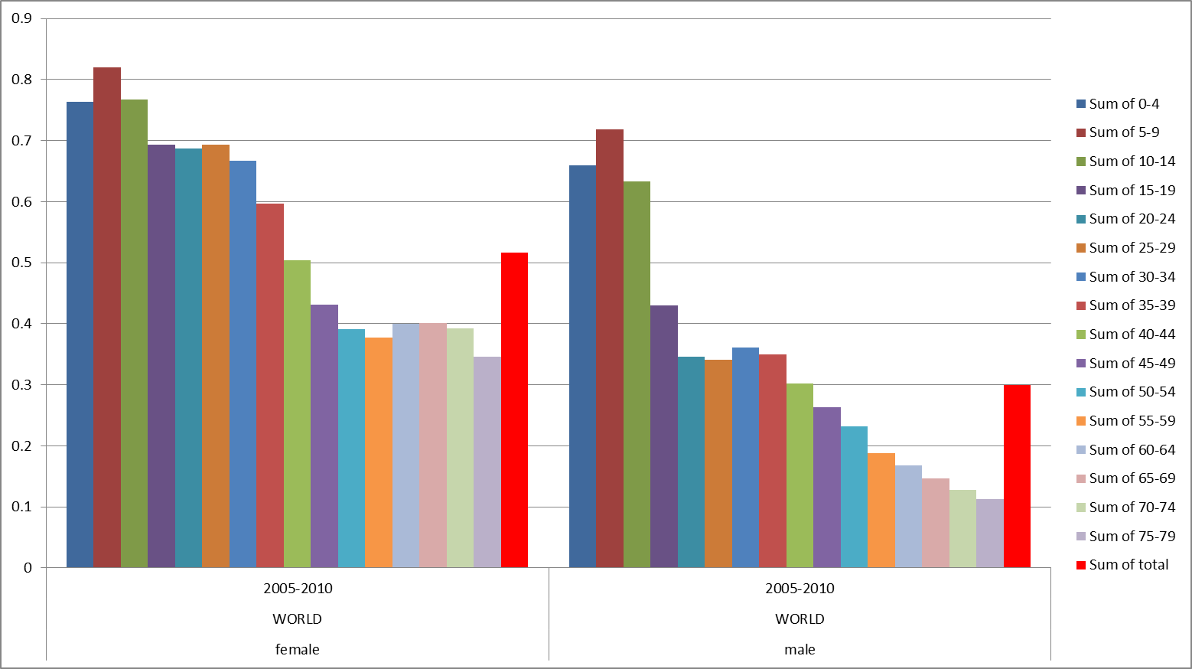
RBGHiE by sex 2005-2010

Slide 12
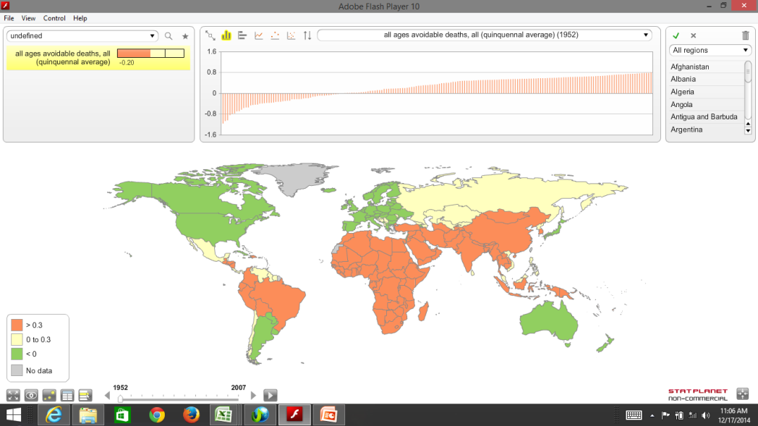
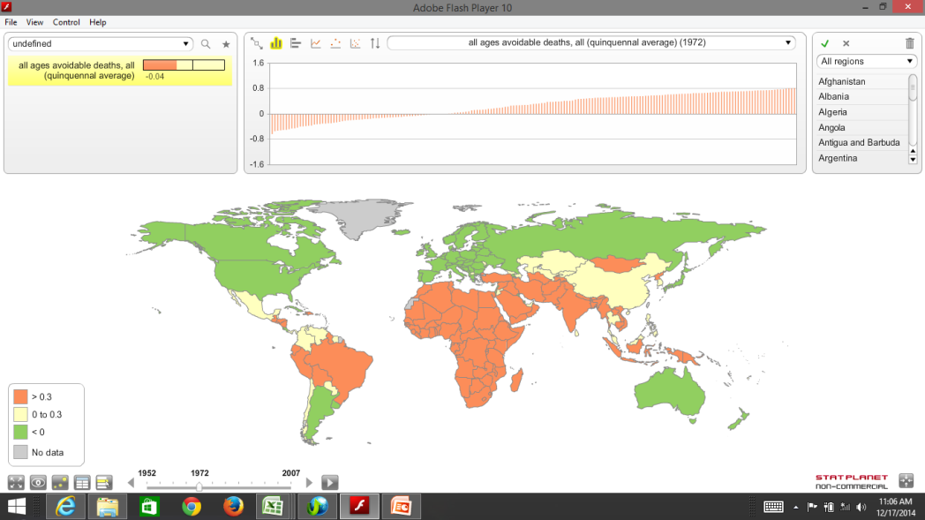
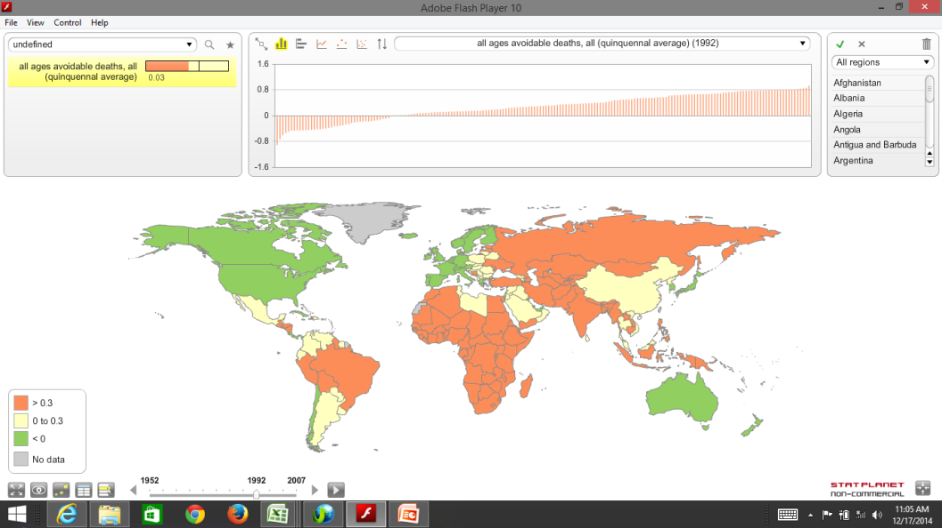
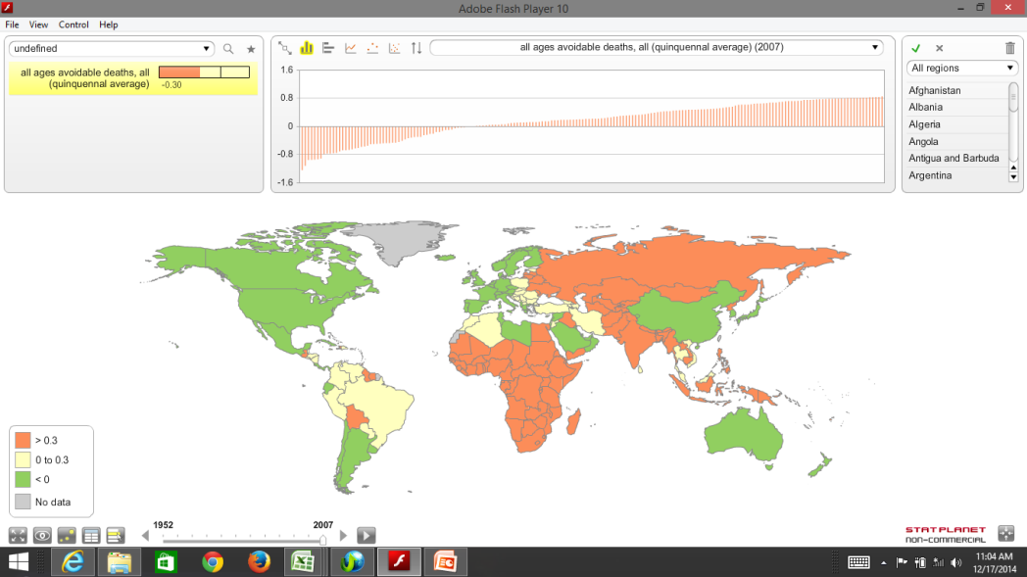
Geographical distribution of RBGHiE 1950-2010

Slide 13
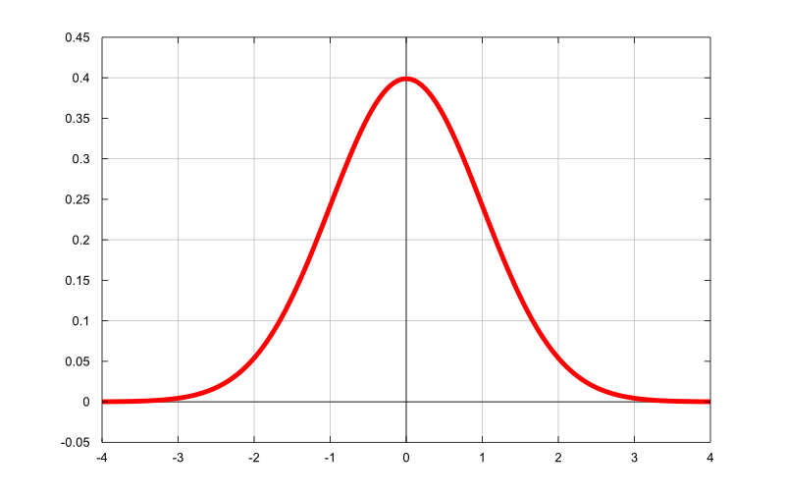
“Equinomics” : Equity curve compatible with the universal right to health
13600 $ pc
5400 $ pc
22800$pc

Slide 14
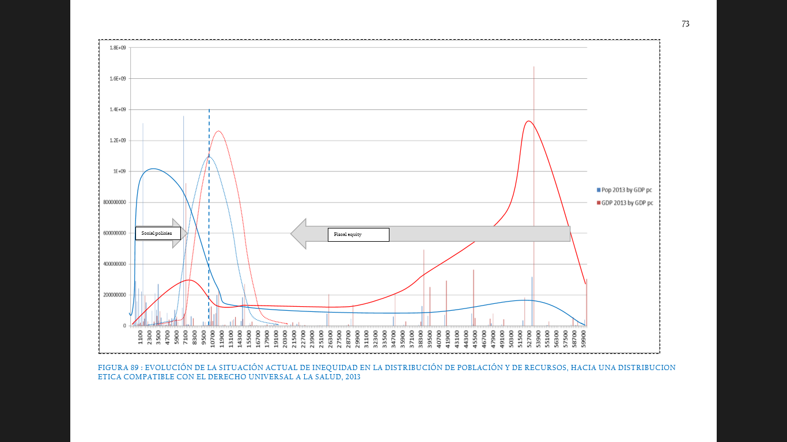

Slide 15
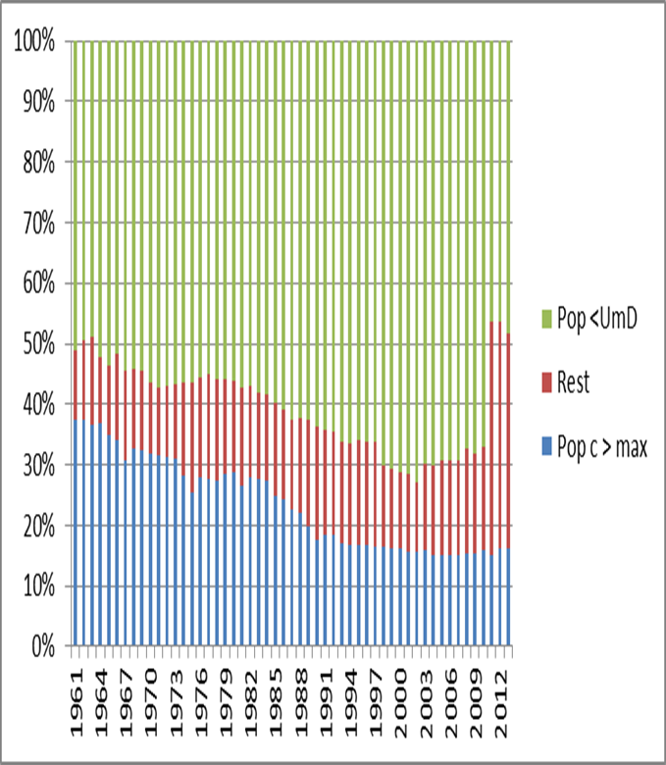
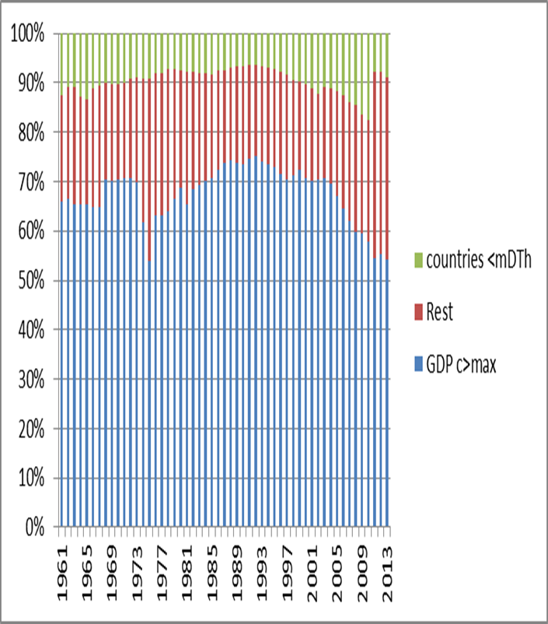
Population and resources ref equity curve

Slide 16
Equity redistribution vs ODA
Dimensions | ODA | Redistribution towards equity
Magnitude/objective | 0.7% of GDP | 10% of GDP
Donnors | OECD/DAC | Countries over max threshold (21750$)
Recipients | OECD/DAC | Countries under min threshold (5187$)
Distribution | Arbitrary | By capacities and needs
Predictibility | Volatile | Binding, stable
Apropiation | Yet low | Global, national

Slide 17
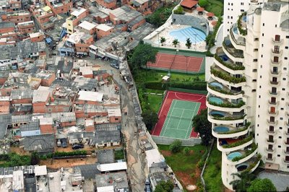
National health inequity

Slide 18
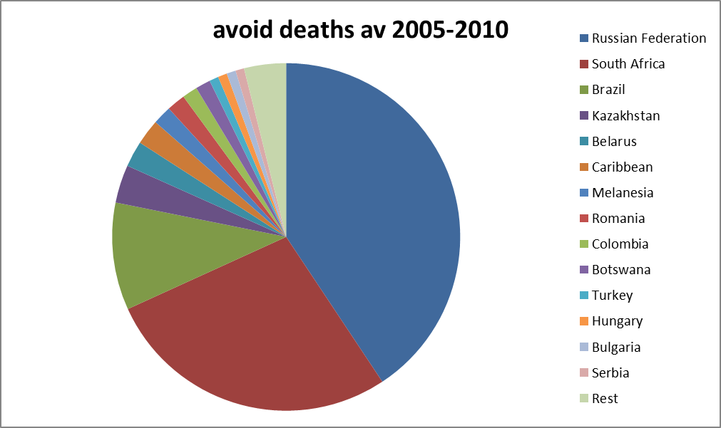
BGHiE in countries > mTh

Slide 19
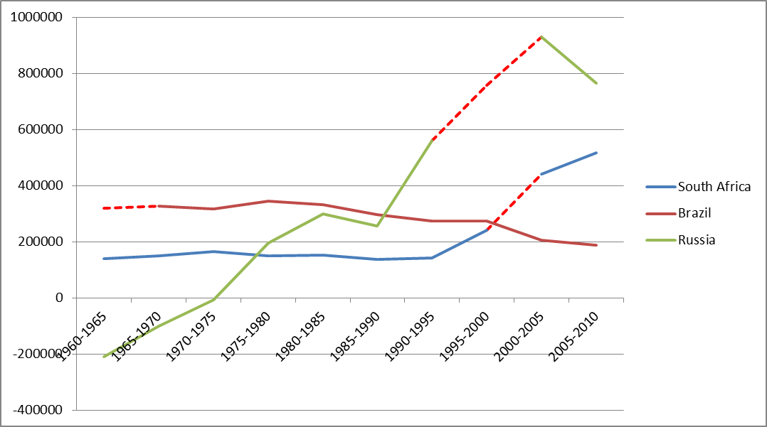
Principales paises sin deficit (>UmD) y con muertes evitables : evolucion en el tiempo

Slide 20
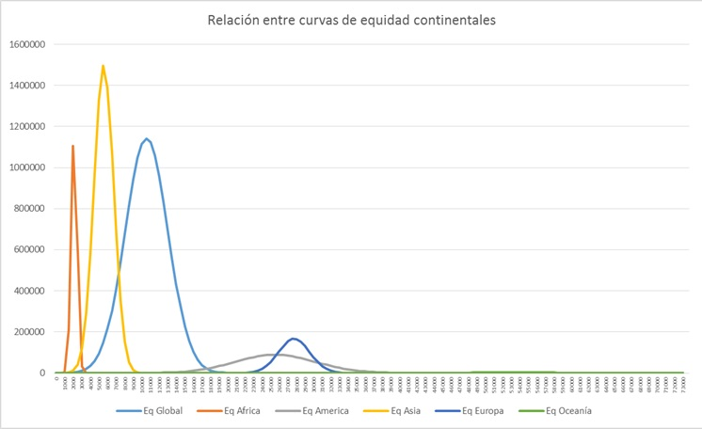

Slide 21
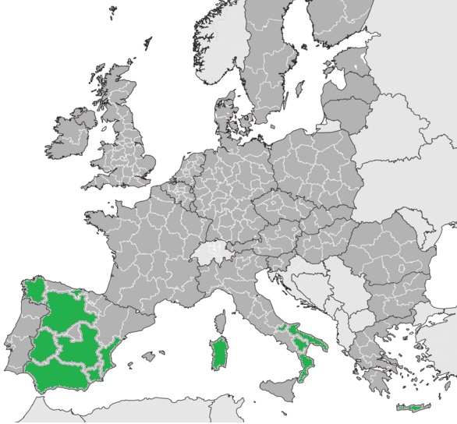
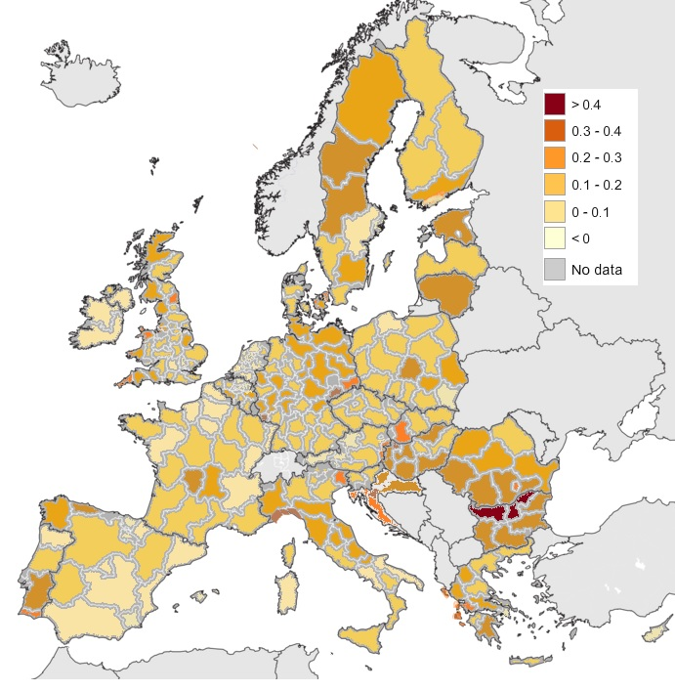
BRHiE in the EU
HR (s) models in the Med region, GDP 30% lower w av and LE some 5% higher.
>760,000 avoidable deaths, some 15% of all deaths, higher in SouthEastern EU

Slide 22
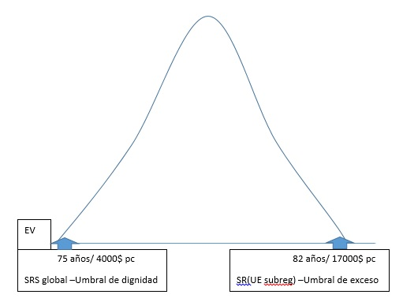
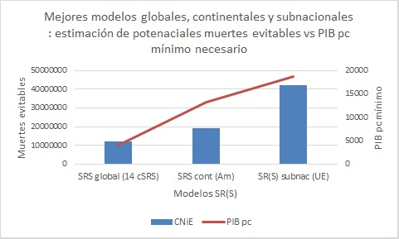

Slide 23
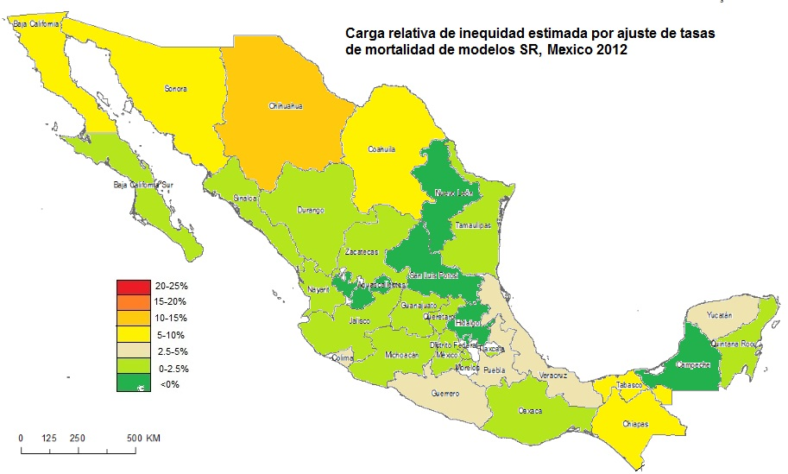
Sub-national health inequity in Mexico by HR (s) States, 2012

Slide 24
Subnational health inequity in Mexico by municipal HR (s) models 2012

Slide 25
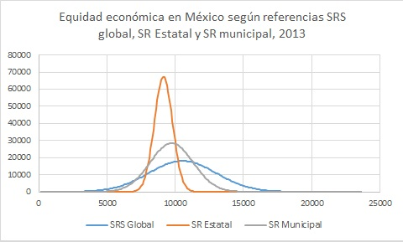
Equity cruves for Mexico ref HRS global, State or municipal 2012

Slide 26
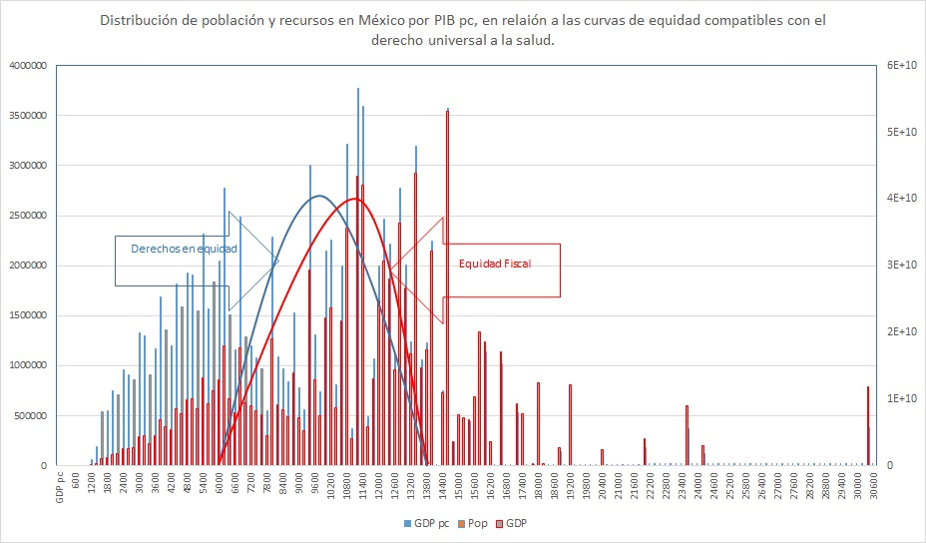

Slide 27
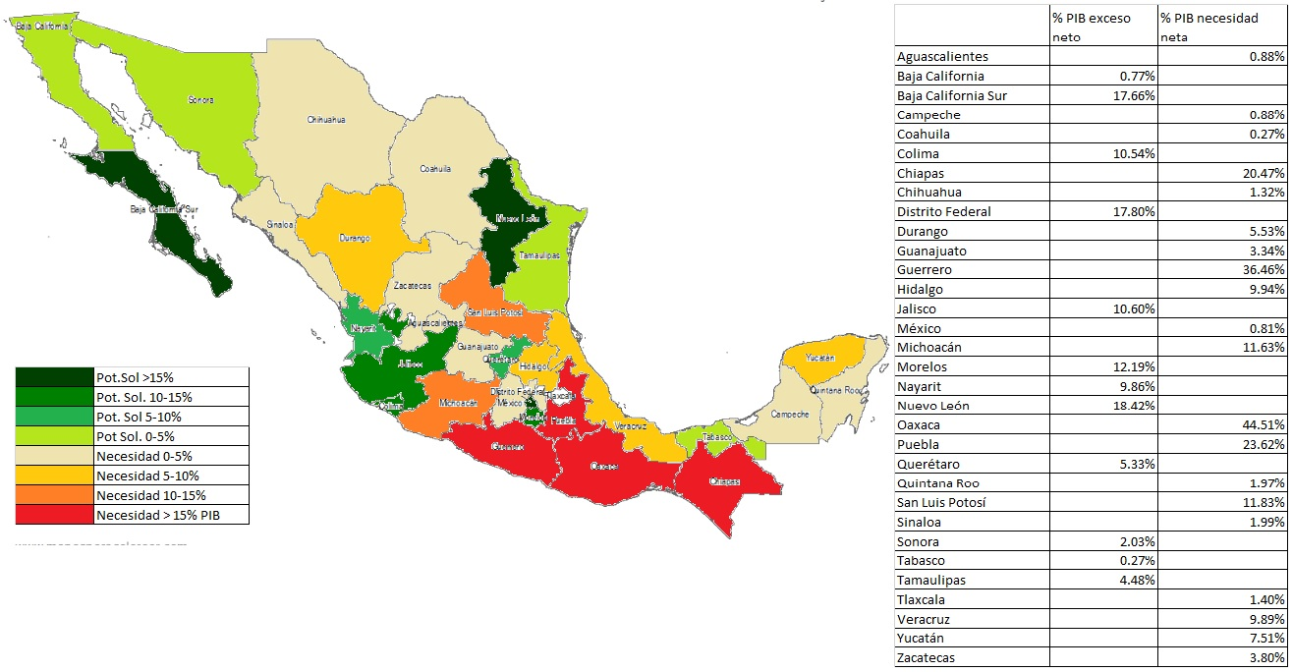

Slide 28
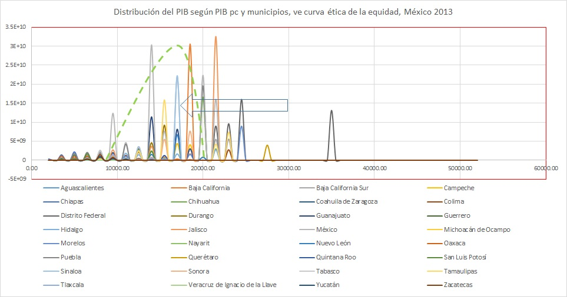

Slide 29
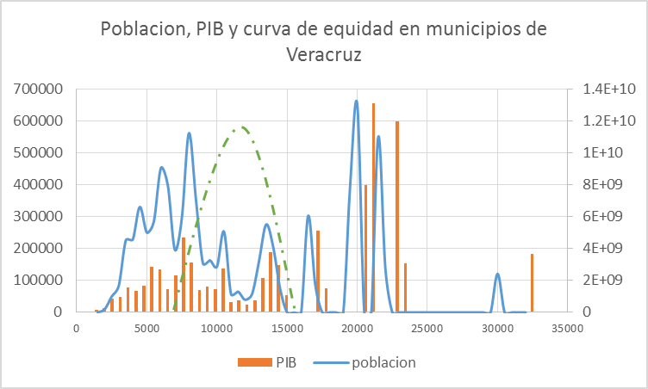
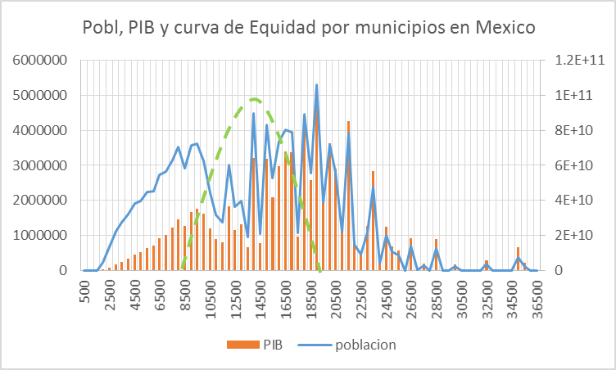
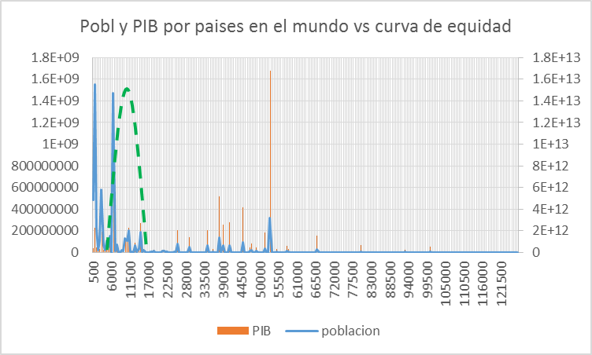
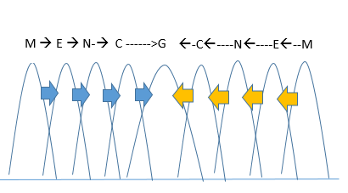

Slide 30
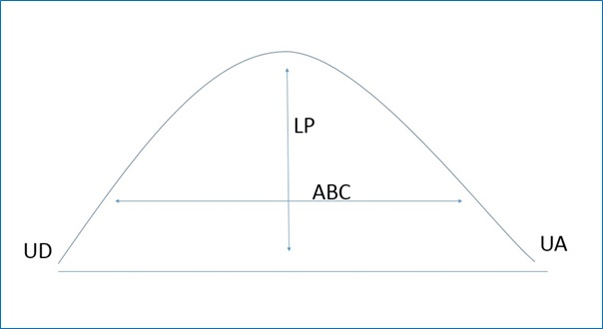

Slide 31
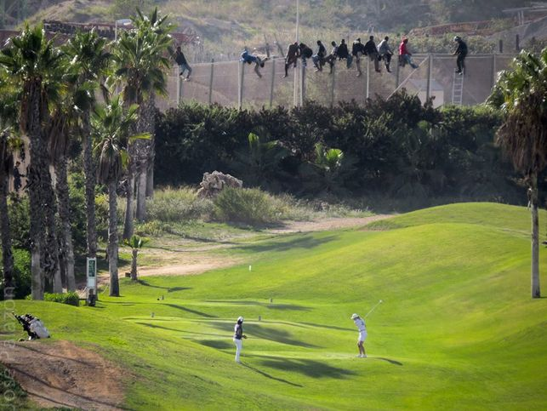
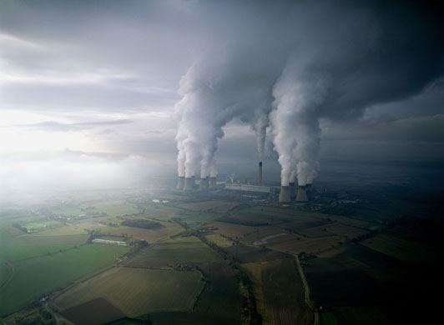

Slide 32
Health equity may be the best barometer of social justice within and between generations. It shifts concepts from poverty to dignity, from poverty alleviation to fiscal and territorial redistribution towards equity curves compatible with universal rights.

