Slide 2
Webinar series-previous sessions
The ethical carbon footprint (08/24)
Carbon and ecological footprints : sustainable models (09/24)
Today´s discusión : which sustainable models are compatible with human wellbeing

Slide 3
Measuring Global Health Inequity by identifying Best Feasible Health Standards
Goal: Quantify global health inequity by benchmarking "best feasible health" (WHO’s objective of achieving optimal health for all).
Focus: Life expectancy as a proxy for well-being, while considering economic (below world GDP per capita) and ecological (sustainable footprint) feasibility factors.
Methodology:
Criteria: 12 key factors include life expectancy, healthy life expectancy, GDP, GNI, wealth, carbon footprint, and biocapacity per capita.
Data Review Cycle: Updated every five years, following UN Population Division’s demographic releases.
Latest Update: Ahead of schedule due to UN projections for 2021-2025.

Slide 4
Key Findings:
Identified countries with higher-than-average life expectancy and feasible economic & ecological standards.
Global Burden of Health Inequity: Calculated by comparing adjusted vs. actual mortality rates.
Interactive Tools: Dashboards, maps, and country reports available in the Global Atlas of Health Equity.

Slide 5
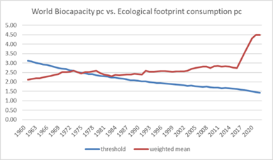
Sustainability Insights:
2023 ecological thresholds:
CO2 emissions: 1.34 metric tons/capita.
Biocapacity: 1.42 hectares/capita.

Slide 6
Sustainability country references
Countries which meet the mentioned ecological sustainability criteria has gradually decreased:
Only 20 countries having met all criteria since 1970 : Afghanistan, Burundi, Benin, Burkina Faso, Comoros, Haiti, Kenya, Cambodia, Sri Lanka, Malawi, Niger, Nepal, Pakistan, Philippines and Rwanda.
1970
2023

Slide 7
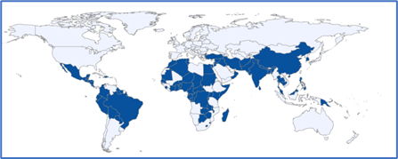
Economic criteria
Countries with GDP/GNI pc CV and PPP, and wealth pc below world average have remained for the last 50 years, interestingly, in the latitudes 20N and 20S
All countries with ecologically sustainable rates have macroeconomic indicators below the world average.
In fact, all of them have wealth pc below 34% and GDP pc in constant value below 44% of the world average.
1970
2023

Slide 8
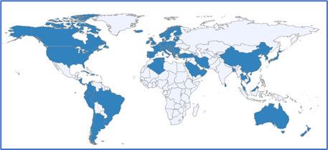
Health criteria
Copuntries with life expec ctancy, disaggregated by sex, and healthy life expectancy (latter only from 1990), above world average:
1990 :most of the Americas –except >CA and Andean región-, Eurasia, parts of Southeast Asia and Australia/New Zealand
2023 : former Sopviet Unionand Mexico dropped while China, most Andean and parts of Northern Africa and Middle East joined
1990
2023

Slide 9
Sustainable, replicable and wellbeing models
The combination of all criteria has resulted in only one country consistently meeting them from 1961 to 2023: Sri Lanka.
Despite maintaining a balance with nature and using less than half the world’s average economic resources (and only 12% of average health spending), Sri Lanka's life expectancy is 9.8% higher than the global average—8.5% higher for men and 10.5% for women.

Slide 10
Deepening the analysis : subnational references
As the sample size increases and the units of analysis decrease, sensitivity improves in identifying more efficient and healthier benchmarks.
Subnational entities in large countries and found sustainable, healthy examples in India (Kerala, Nagaland), China (Shanxi, Guangxi, Anhui, Sichuan, Henan), Russia (Ingushetia, Chechnya, Kabardino, Dagestan, Karachay in the North Caucasus), Indonesia(Sulawesi, Kalimantan, Bali, Java), Pakistan (FATA), and Brazil (Piaui, Alagoas, Paraiba, Ceara, Para, Rio Grande do Norte). Conversely, we found none in the United States or Nigeria (neither met sustainability or health criteria), while Bangladesh has emerged, alongside Sri Lanka, as a model of sustainable health over the last three years.

